Slide 1

Chapter 4:
Making Decisions

Slide 2
4.1
Relational Operators

Slide 3

Relational Operators
Used to compare numbers to determine relative order
Operators:
> | Greater than
< | Less than
>= | Greater than or equal to
<= | Less than or equal to
== | Equal to
!= | Not equal to

Slide 4
Relational Expressions
Boolean expressions – true or false
Examples:
  12 > 5 is true
  7 <= 5 is false
  if x is 10, then
  x == 10 is true,
  x != 8 is true, and
  x == 8 is false

Slide 5
Relational Expressions
Can be assigned to a variable:
  result = x <= y;
Assigns 0 for false, 1 for true
Do not confuse = and ==

Slide 6
4.2
The if Statement

Slide 7
The if Statement
Allows statements to be conditionally executed or skipped over
Models the way we mentally evaluate situations:
  "If it is raining, take an umbrella."
  "If it is cold outside, wear a coat."

Slide 8
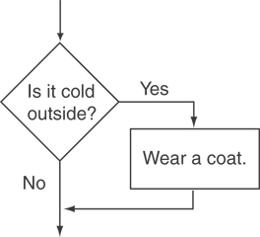
Flowchart for Evaluating a Decision

Slide 9
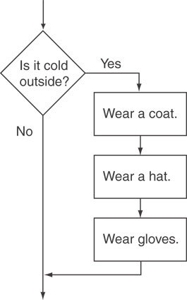
Flowchart for Evaluating a Decision

Slide 10
The if Statement
General Format:
  if (expression)
  statement;

Slide 11
The if Statement-What Happens
To evaluate:
  if (expression)
  statement;
If the expression is true, then statement is executed.
If the expression is false, then statement is skipped.

Slide 12
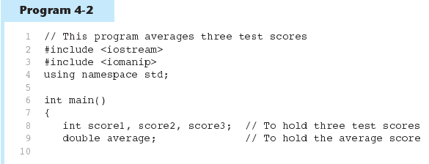
if Statement in Program 4-2
Continued…

Slide 13
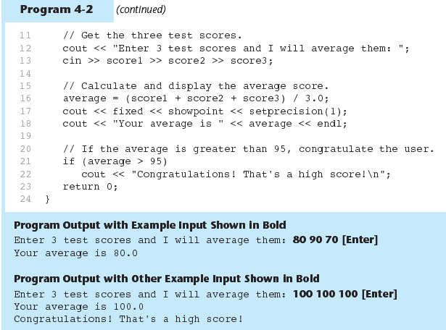
if Statement in Program 4-2

Slide 14
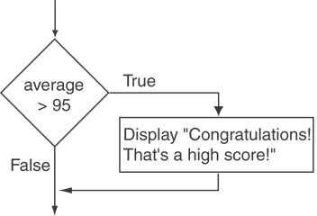
Flowchart for Program 4-2 Lines 21 and 22

Slide 15
if Statement Notes
Do not place ; after (expression)
Place statement; on a separate line after (expression), indented:
  if (score > 90)
  grade = 'A';
Be careful testing floats and doubles for equality
0 is false; any other value is true

Slide 16
4.3
Expanding the if Statement

Slide 17
Expanding the if Statement
To execute more than one statement as part of an if statement, enclose them in { }:
  if (score > 90)
  {
  grade = 'A';
  cout << "Good Job!\n";
  }
{ } creates a block of code

Slide 18
4.4
The if/else Statement

Slide 19
The if/else statement
Provides two possible paths of execution
Performs one statement or block if the expression is true, otherwise performs another statement or block.

Slide 20
The if/else statement
General Format:
  if (expression)
  statement1; // or block
  else
  statement2; // or block

Slide 21
if/else-What Happens
To evaluate:
  if (expression)
  statement1;
  else
  statement2;
If the expression is true, then statement1 is executed and statement2 is skipped.
If the expression is false, then statement1 is skipped and statement2 is executed.

Slide 22
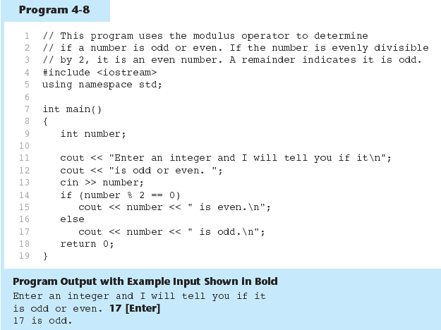
The if/else statement and Modulus Operator in Program 4-8

Slide 23
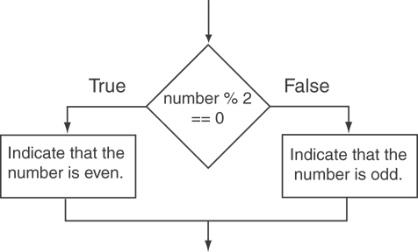
Flowchart for Program 4-8 Lines 14 through 18

Slide 24
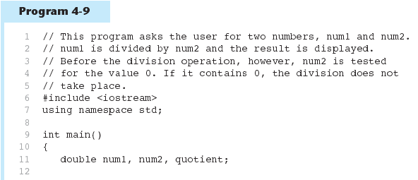
Testing the Divisor in Program 4-9
Continued…

Slide 25
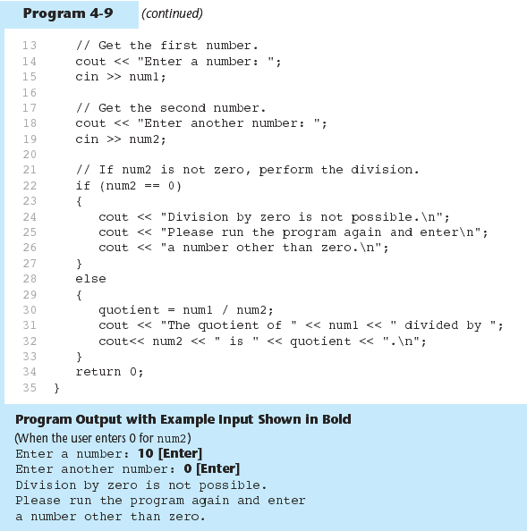
Testing the Divisor in Program 4-9

